Slide 1
APL 745: Deep Learning in Mechanics
Topics:
Recurrent Neural Networks (RNNs)
(Truncated) BackProp Through Time (BPTT)
LSTMs
Sitikantha Roy
IIT Delhi

Slide 2

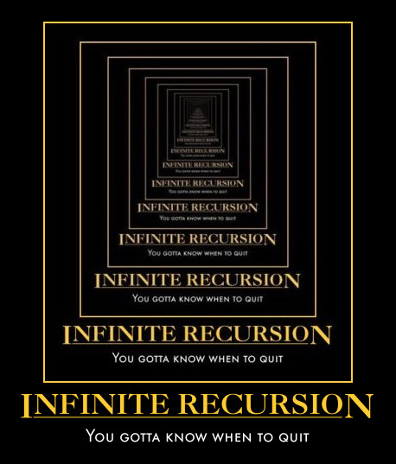
New Topic: RNNs
Image Credit: Andrej Karpathy

Slide 3
New terminologies
Recurrent Neural Networks (RNNs)
Recursive Neural Networks
General family; think graphs instead of chains
Types:
“Vanilla” RNNs (Elman Networks)
Long Short Term Memory (LSTMs)
Gated Recurrent Units (GRUs)
…
Algorithms
BackProp Through Time (BPTT)
BackProp Through Structure (BPTS)

Slide 4
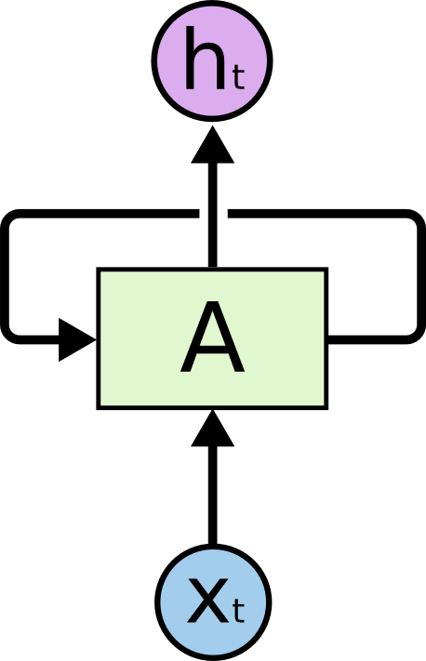

Humans don’t start their thinking from scratch every second. As you read this essay, you understand each word based on your understanding of previous words. You don’t throw everything away and start thinking from scratch again. Your thoughts have persistence.
Traditional neural networks can’t do this, and it seems like a major shortcoming. For example, imagine you want to classify what kind of event is happening at every point in a movie. It’s unclear how a traditional neural network could use its reasoning about previous events in the film to inform later ones
Recurrent neural networks address this issue. They are networks with loops in them, allowing information to persist. Recurrent Neural Networks have loops.
This chain-like nature reveals that recurrent neural networks are intimately related to sequences and lists. They’re the natural architecture of neural network to use for such data.
And they certainly are used! In the last few years, there have been incredible success applying RNNs to a variety of problems: speech recognition, language modeling, translation, image captioning… The list goes on.

Slide 5
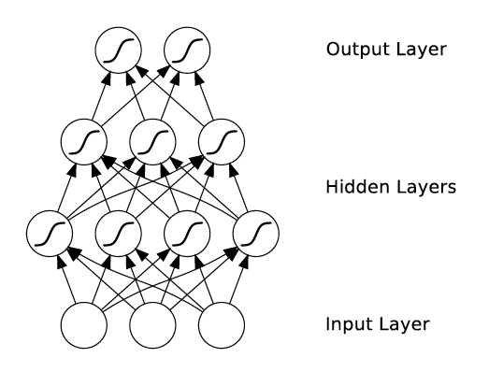
What’s wrong with MLPs?
Problem 1: Can’t model sequences
Fixed-sized Inputs & Outputs
No temporal structure
Problem 2: Pure feed-forward processing
No “memory”, no feedback
Each input to network,
was independent of the
previous or future inputs
Computations, output and
decisions for two successive
Images (CNN) are completely
Independent of each other.
Image Credit: Alex Graves, book

Slide 6
Why model sequences?
Figure Credit: Carlos Guestrin

Slide 7
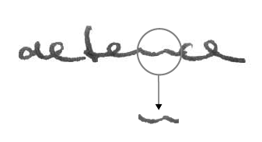
Why model sequences?
Image Credit: Alex Graves

Slide 8
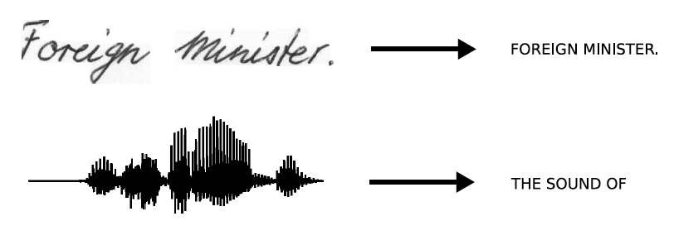
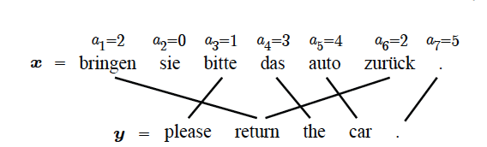
Sequences are everywhere…
Hand writing recognition
Voice recognition, speech to text conversion. Both speech and text are sequence
Machine translation
Image Credit: Alex Graves and Kevin Gimpel

Slide 9
Sequences in Input or Output?
It’s a spectrum…
Input: No sequence
Output: No sequence
Example: “standard” classification / regression problems
Input: No sequence
Output: Sequence
Example: Im2Caption
Input: Sequence
Output: No sequence
Example: sentence classification, multiple-choice question answering
Input: Sequence
Output: Sequence
Example: machine translation, video classification, video captioning, open-ended question answering
Image Credit: Andrej Karpathy

Slide 10
2 Key Ideas
Parameter Sharing
in computation graphs = adding gradients
“Unrolling”
in computation graphs with parameter sharing
The above two accommodates the following …
Account for dependency between inputs
Account for variable number of inputs
Make sure the function executed at each time step is the same. Why?

Slide 11
Computational Graph
Slide Credit: Marc'Aurelio Ranzato

Slide 12
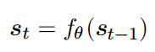
How do we model sequences?
No input
Image Credit: Bengio, Goodfellow, Courville

Slide 13
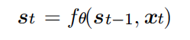
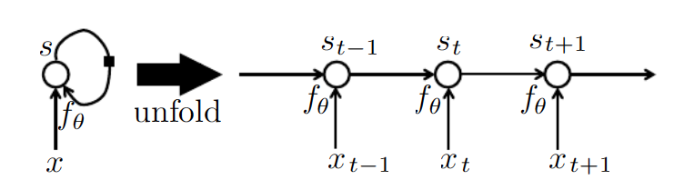
How do we model sequences?
With inputs
Image Credit: Bengio, Goodfellow, Courville

Slide 14
2 Key Ideas
Parameter Sharing
in computation graphs = adding gradients
“Unrolling”
in computation graphs with parameter sharing
Parameter sharing + Unrolling
Allows modeling arbitrary sequence lengths!
Keeps numbers of parameters in check

Slide 15
Recurrence in Recurrent Neural Network
Key idea: RNNs have an internal state
that is updated as the sequence is
processed. Self looping..
Internal sate is some kind of memory,
which will keep track of what has
happened before in the data in the past.
Retaining the information of the past.
RNN
x
Slide Credit: Fei-Fei Li, Justin Johnson, Serena Yeung, CS 231n

Slide 16
Recurrent Neural Network
y
usually want to predict a vector at some time steps
RNN
x
RNN Block: Can have 1 or many hidden layers
Could have skip connections
Or any other architecture
Slide Credit: Fei-Fei Li, Justin Johnson, Serena Yeung, CS 231n

Slide 17
Unfolded RNN
y1
y2
y3
y4
y5
RNN
RNN
RNN
RNN
RNN
x1
x2
x3
x4
xt
Given a problem we need to decided what is “t” going to be, how much we want to unroll to derive inference.
Do we want look at past 20 frames, 100 frames or 200 frames to make a decision about a video. That will determine
Number in the sequence. This is pre-decided before the training…

Slide 18
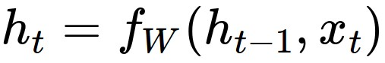
Recurrent Neural Network
We can process a sequence of vectors x by applying a recurrence formula at every time step:
y
RNN
new state
old state
input vector at some time step
some function
with parameters W
x
W=U, V the sets of parameters in the model
Slide Credit: Fei-Fei Li, Justin Johnson, Serena Yeung, CS 231n

Slide 19
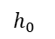
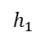
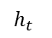
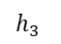
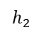
y1
y2
y3
y4
yt
RNN
$$h_{1}$$
RNN
$$h_{2}$$
RNN
$$h_{3}$$
RNN
$$h_{t}$$
RNN
$$h_{0}$$
x1
x2
x3
x4
xt

Slide 20
Recurrent Neural Network
We can process a sequence of vectors x by applying a recurrence formula at every time step:
y
RNN
Notice: the same function and the same set of parameters are used at every time step.
x
Slide Credit: Fei-Fei Li, Justin Johnson, Serena Yeung, CS 231n

Slide 21
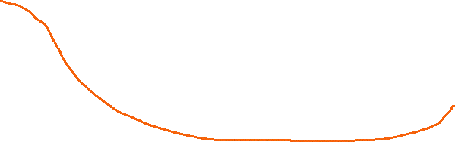


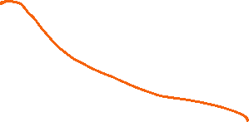



(Vanilla) Recurrent Neural Network
The state consists of a single “hidden” vector h:
y
RNN
x
Sometimes called a “Vanilla RNN” or an “Elman RNN” after Prof. Jeffrey Elman
Slide Credit: Fei-Fei Li, Justin Johnson, Serena Yeung, CS 231n

Slide 22
RNN: Computational Graph
h₀
f_{W}
h₁
x₁
Slide Credit: Fei-Fei Li, Justin Johnson, Serena Yeung, CS 231n

Slide 23
RNN: Computational Graph
h₀
h₁
h₂
h₃
…
h_{T}
f_{W}
f_{W}
f_{W}
x₁
x₂
x₃
Slide Credit: Fei-Fei Li, Justin Johnson, Serena Yeung, CS 231n

Slide 24
RNN: Computational Graph
Re-use the same weight matrix at every time-step
h₀
h₁
h₂
h₃
…
h_{T}
f_{W}
f_{W}
f_{W}
x₁
x₂
x₃
W
Slide Credit: Fei-Fei Li, Justin Johnson, Serena Yeung, CS 231n

Slide 25
L
RNN: Computational Graph: Many to Many
y₁
y₂
y₃
y_{T}
L₁
L₂
L₃
L_{T}
h₀
h₁
h₂
h₃
…
h_{T}
f_{W}
f_{W}
f_{W}
x₁
x₂
x₃
W
Slide Credit: Fei-Fei Li, Justin Johnson, Serena Yeung, CS 231n

Slide 26
RNN: Computational Graph: Many to One
y
h₀
h₁
h₂
h₃
…
h_{T}
f_{W}
f_{W}
f_{W}
x₁
x₂
x₃
W
Slide Credit: Fei-Fei Li, Justin Johnson, Serena Yeung, CS 231n

Slide 27
RNN: Computational Graph: One to Many
y₁
y₂
y₃
y_{T}
h₀
h₁
h₂
h₃
…
h_{T}
f_{W}
f_{W}
f_{W}
x
W
Slide Credit: Fei-Fei Li, Justin Johnson, Serena Yeung, CS 231n

Slide 28
Sequence to Sequence: Many-to-one + one-to-many
One to many: Produce output sequence from single input vector
Many to one: Encode input sequence in a single vector
y₁
y₂
h₀
f_{W}
h₁
f_{W}
h₂
f_{W}
h₃
…
h_{T}
h₁
h₂
…
f_{W}
f_{W}
f_{W}
x₁
x₂
x₃
W₁
W₂
Slide Credit: Fei-Fei Li, Justin Johnson, Serena Yeung, CS 231n

Slide 29
Computational Graph: Basics

Slide 30
Plan for Today
Recurrent Neural Networks (RNNs)
Example Problem: (Character-level) Language modeling
Learning: (Truncated) BackProp Through Time (BPTT)
Visualizing RNNs
Example: Image Captioning
Inference: Beam Search
Multilayer RNNs
Problems with gradients in “vanilla” RNNs
LSTMs (and other RNN variants)

Slide 31

Language Modeling
Given a dataset, build an accurate model: P(y₁, y₂, …y_{T})
Image Credit: https://ofir.io/Neural-Language-Modeling-From-Scratch/

Slide 32
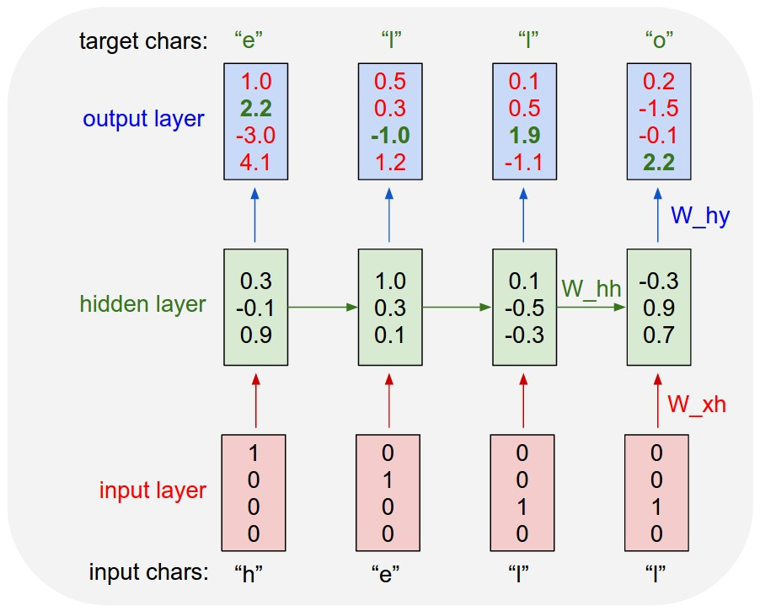
Example: Character-level
Language Model
Vocabulary:
[h,e,l,o]
Example training
sequence:
“hello”
Slide Credit: Fei-Fei Li, Justin Johnson, Serena Yeung, CS 231n

Slide 33
Example: Character-level
Language Model
Vocabulary:
[h,e,l,o]
Example training
sequence:
“hello”
Slide Credit: Fei-Fei Li, Justin Johnson, Serena Yeung, CS 231n

Slide 34
Example: Character-level
Language Model
Vocabulary:
[h,e,l,o]
Example training
sequence:
“hello”
Slide Credit: Fei-Fei Li, Justin Johnson, Serena Yeung, CS 231n

Slide 35
Example: Character-level
Language Model
Vocabulary:
[h,e,l,o]
Example training
sequence:
“hello”
Slide Credit: Fei-Fei Li, Justin Johnson, Serena Yeung, CS 231n

Slide 36
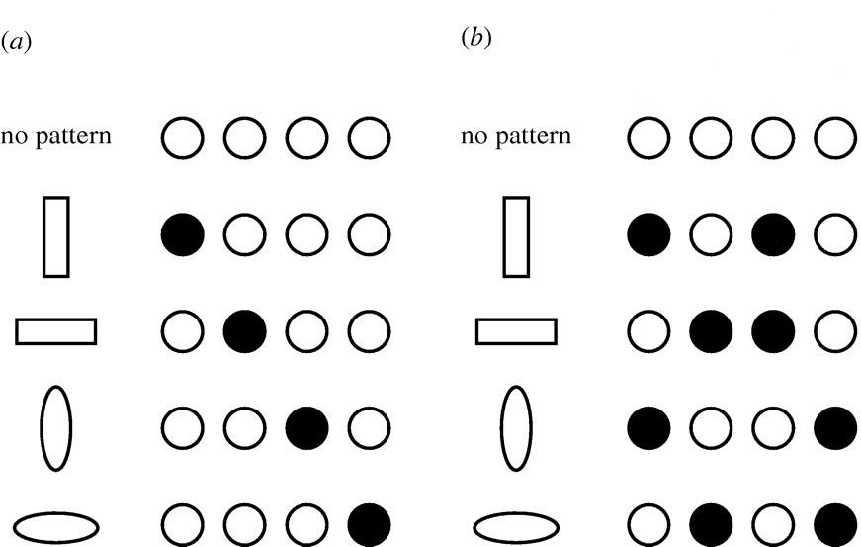
Distributed Representations Toy Example
Local vs Distributed
Slide Credit: Moontae Lee

Slide 37
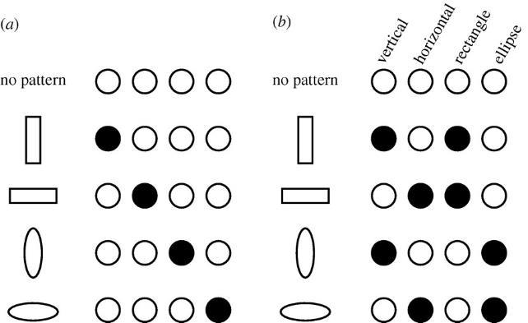
Distributed Representations Toy Example
Can we interpret each dimension?
Slide Credit: Moontae Lee

Slide 38
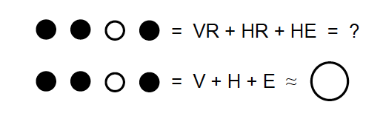
Power of distributed representations!
Local
Distributed
Slide Credit: Moontae Lee

Slide 39
Example: Character-level
Language Model
Vocabulary:
[h,e,l,o]
Example training
sequence:
“hello”
Slide Credit: Fei-Fei Li, Justin Johnson, Serena Yeung, CS 231n

Slide 40
Training Time: MLE / “Teacher Forcing”
Example: Character-level
Language Model
Vocabulary:
[h,e,l,o]
Example training
sequence:
“hello”
Slide Credit: Fei-Fei Li, Justin Johnson, Serena Yeung, CS 231n

Slide 41
Test Time: Sample / Argmax / Beam Search
Example: Character-level
Language Model
Sampling
Vocabulary:
[h,e,l,o]
At test-time sample characters one at a time, feed back to model
“e”
“l”
“l”
“o”
Sample
.03
.13
.00
.84
.25
.20
.05
.50
.11
.17
.68
.03
.11
.02.08
.79
Softmax
Slide Credit: Fei-Fei Li, Justin Johnson, Serena Yeung, CS 231n

Slide 42
Test Time: Sample / Argmax / Beam Search
Example: Character-level
Language Model
Sampling
Vocabulary:
[h,e,l,o]
At test-time sample characters one at a time, feed back to model
“e”
“l”
“l”
“o”
Sample
.03
.13
.00
.84
.25
.20
.05
.50
.11
.17
.68
.03
.11
.02.08
.79
Softmax
Slide Credit: Fei-Fei Li, Justin Johnson, Serena Yeung, CS 231n

Slide 43
Test Time: Sample / Argmax / Beam Search
Example: Character-level
Language Model
Sampling
Vocabulary:
[h,e,l,o]
At test-time sample characters one at a time, feed back to model
“e”
“l”
“l”
“o”
Sample
.03
.13
.00
.84
.25
.20
.05
.50
.11
.17
.68
.03
.11
.02.08
.79
Softmax
Slide Credit: Fei-Fei Li, Justin Johnson, Serena Yeung, CS 231n

Slide 44
Test Time: Sample / Argmax / Beam Search
Example: Character-level
Language Model
Sampling
Vocabulary:
[h,e,l,o]
At test-time sample characters one at a time, feed back to model
“e”
“l”
“l”
“o”
Sample
.03
.13
.00
.84
.25
.20
.05
.50
.11
.17
.68
.03
.11
.02.08
.79
Softmax
Slide Credit: Fei-Fei Li, Justin Johnson, Serena Yeung, CS 231n

Slide 45
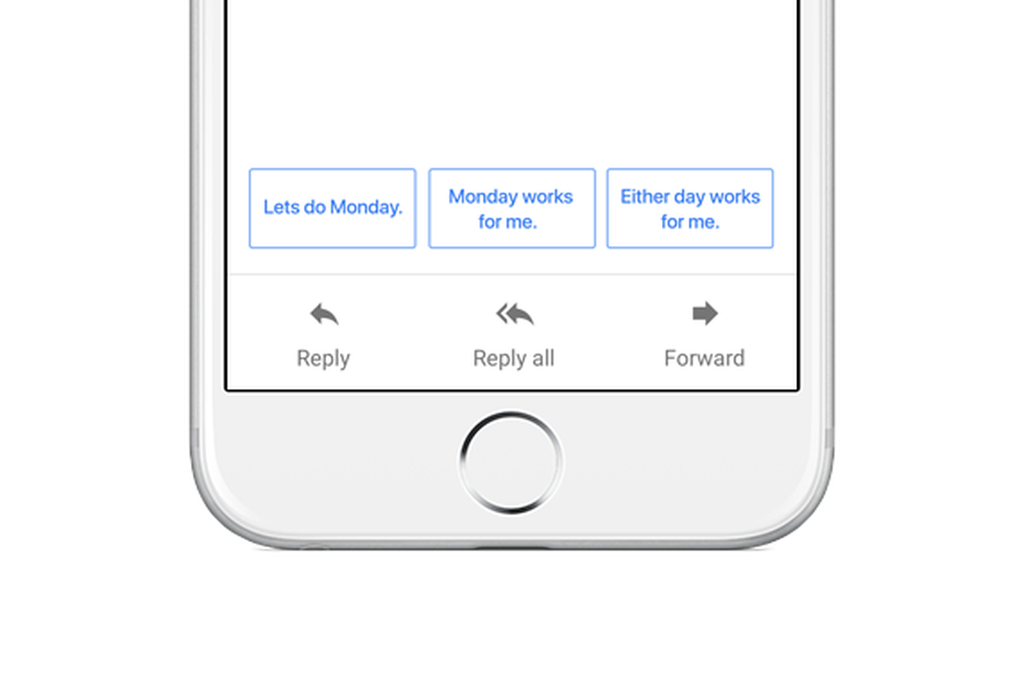

Slide 46
Forward through entire sequence to compute loss, then backward through entire sequence to compute gradient
Backpropagation through time
Loss
Slide Credit: Fei-Fei Li, Justin Johnson, Serena Yeung, CS 231n

Slide 47
Truncated Backpropagation through time
Loss
Run forward and backward through chunks of the sequence instead of whole sequence
Slide Credit: Fei-Fei Li, Justin Johnson, Serena Yeung, CS 231n

Slide 48
Truncated Backpropagation through time
Loss
Carry hidden states forward in time forever, but only backpropagate for some smaller number of steps
Slide Credit: Fei-Fei Li, Justin Johnson, Serena Yeung, CS 231n

Slide 49
Truncated Backpropagation through time
Loss
Slide Credit: Fei-Fei Li, Justin Johnson, Serena Yeung, CS 231n

Slide 50
Plan for Today
Recurrent Neural Networks (RNNs)
Example Problem: (Character-level) Language modeling
Learning: (Truncated) BackProp Through Time (BPTT)
Visualizing RNNs
Example: Image Captioning
Inference: Beam Search
Multilayer RNNs
Problems with gradients in “vanilla” RNNs
LSTMs (and other RNN variants)

Slide 51
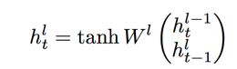
Multilayer RNNs
depth
time
Slide Credit: Fei-Fei Li, Justin Johnson, Serena Yeung, CS 231n

Slide 52
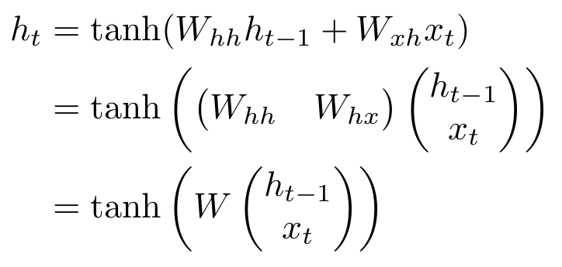
Vanilla RNN Gradient Flow
Bengio et al, “Learning long-term dependencies with gradient descent is difficult”, IEEE Transactions on Neural Networks, 1994
Pascanu et al, “On the difficulty of training recurrent neural networks”, ICML 2013
W
tanh
h_{t-1}
h_{t}
stack
x_{t}
Slide Credit: Fei-Fei Li, Justin Johnson, Serena Yeung, CS 231n

Slide 53
Vanilla RNN Gradient Flow
Bengio et al, “Learning long-term dependencies with gradient descent is difficult”, IEEE Transactions on Neural Networks, 1994
Pascanu et al, “On the difficulty of training recurrent neural networks”, ICML 2013
Backpropagation from h_{t} to h_{t-1} multiplies by W (actually W_{hh})
W
tanh
h_{t-1}
h_{t}
stack
x_{t}
Slide Credit: Fei-Fei Li, Justin Johnson, Serena Yeung, CS 231n

Slide 54
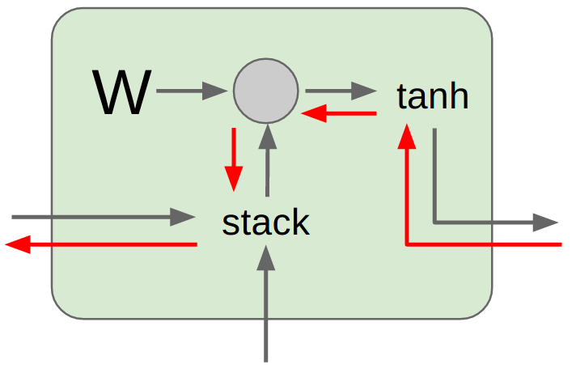
Vanilla RNN Gradient Flow
Bengio et al, “Learning long-term dependencies with gradient descent is difficult”, IEEE Transactions on Neural Networks, 1994
Pascanu et al, “On the difficulty of training recurrent neural networks”, ICML 2013
h₀
h₁
h₂
h₃
h₄
x₁
x₂
x₃
x₄
Computing gradient of h₀ involves many factors of W
(and repeated tanh)
Slide Credit: Fei-Fei Li, Justin Johnson, Serena Yeung, CS 231n

Slide 55
Vanilla RNN Gradient Flow
Bengio et al, “Learning long-term dependencies with gradient descent is difficult”, IEEE Transactions on Neural Networks, 1994
Pascanu et al, “On the difficulty of training recurrent neural networks”, ICML 2013
h₀
h₁
h₂
h₃
h₄
x₁
x₂
x₃
x₄
Largest singular value > 1: Exploding gradients
Largest singular value < 1:
Vanishing gradients
Computing gradient of h₀ involves many factors of W
(and repeated tanh)
Slide Credit: Fei-Fei Li, Justin Johnson, Serena Yeung, CS 231n

Slide 56
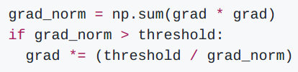
Vanilla RNN Gradient Flow
Bengio et al, “Learning long-term dependencies with gradient descent is difficult”, IEEE Transactions on Neural Networks, 1994
Pascanu et al, “On the difficulty of training recurrent neural networks”, ICML 2013
h₀
h₁
h₂
h₃
h₄
x₁
x₂
x₃
x₄
Largest singular value > 1: Exploding gradients
Largest singular value < 1:
Vanishing gradients
Gradient clipping: Scale gradient if its norm is too big
Computing gradient of h₀ involves many factors of W
(and repeated tanh)
Slide Credit: Fei-Fei Li, Justin Johnson, Serena Yeung

Slide 57
Vanilla RNN Gradient Flow
Bengio et al, “Learning long-term dependencies with gradient descent is difficult”, IEEE Transactions on Neural Networks, 1994
Pascanu et al, “On the difficulty of training recurrent neural networks”, ICML 2013
h₀
h₁
h₂
h₃
h₄
x₁
x₂
x₃
x₄
Largest singular value > 1: Exploding gradients
Largest singular value < 1:
Vanishing gradients
Computing gradient of h₀ involves many factors of W
(and repeated tanh)
Change RNN architecture
Slide Credit: Fei-Fei Li, Justin Johnson, Serena Yeung, CS 231n

Slide 58
How to tackle vanishing gradients
Use ReLU, instead of sigmoid and tanh. ReLU does not vanish the gradient, it keeps the gradient positive.
Regularization.
Better initialization of weights.
Use only short time sequences (Truncated BacProp)
How to overcome limitations of RNN, by changing the architecture?

Slide 59
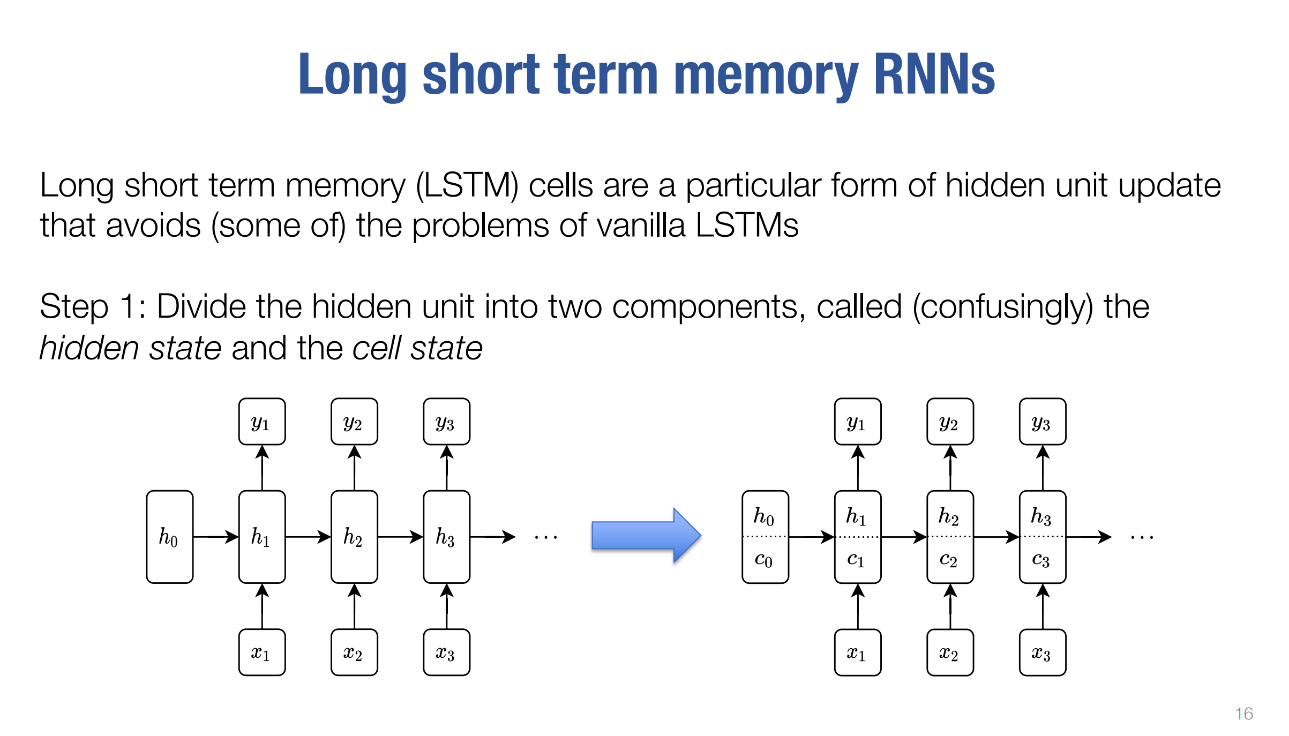

Slide 60
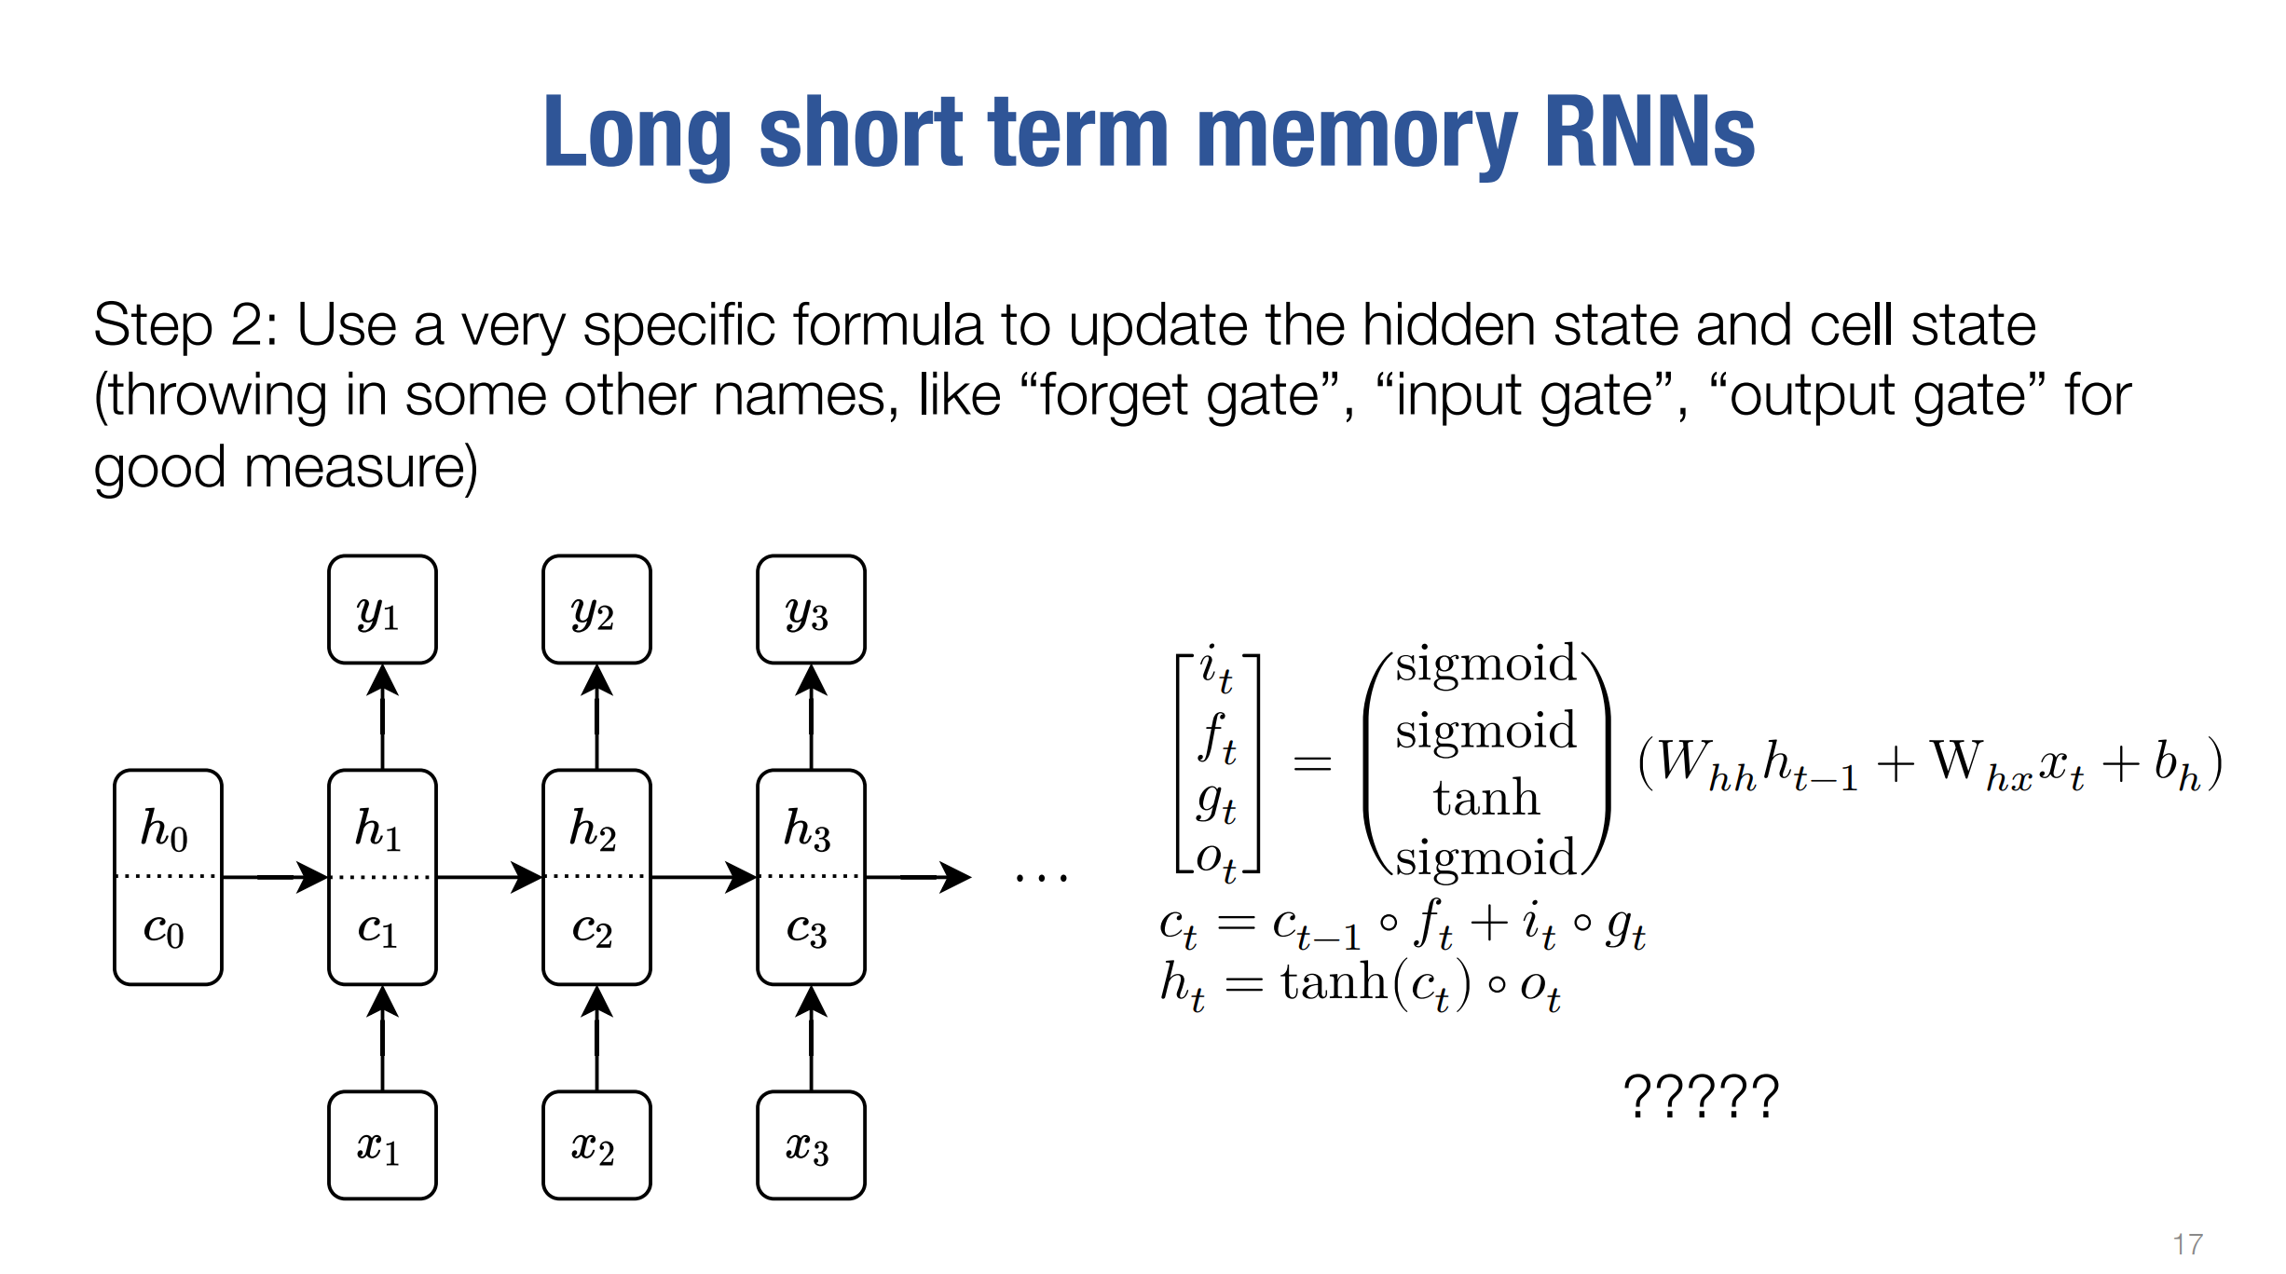

Slide 61
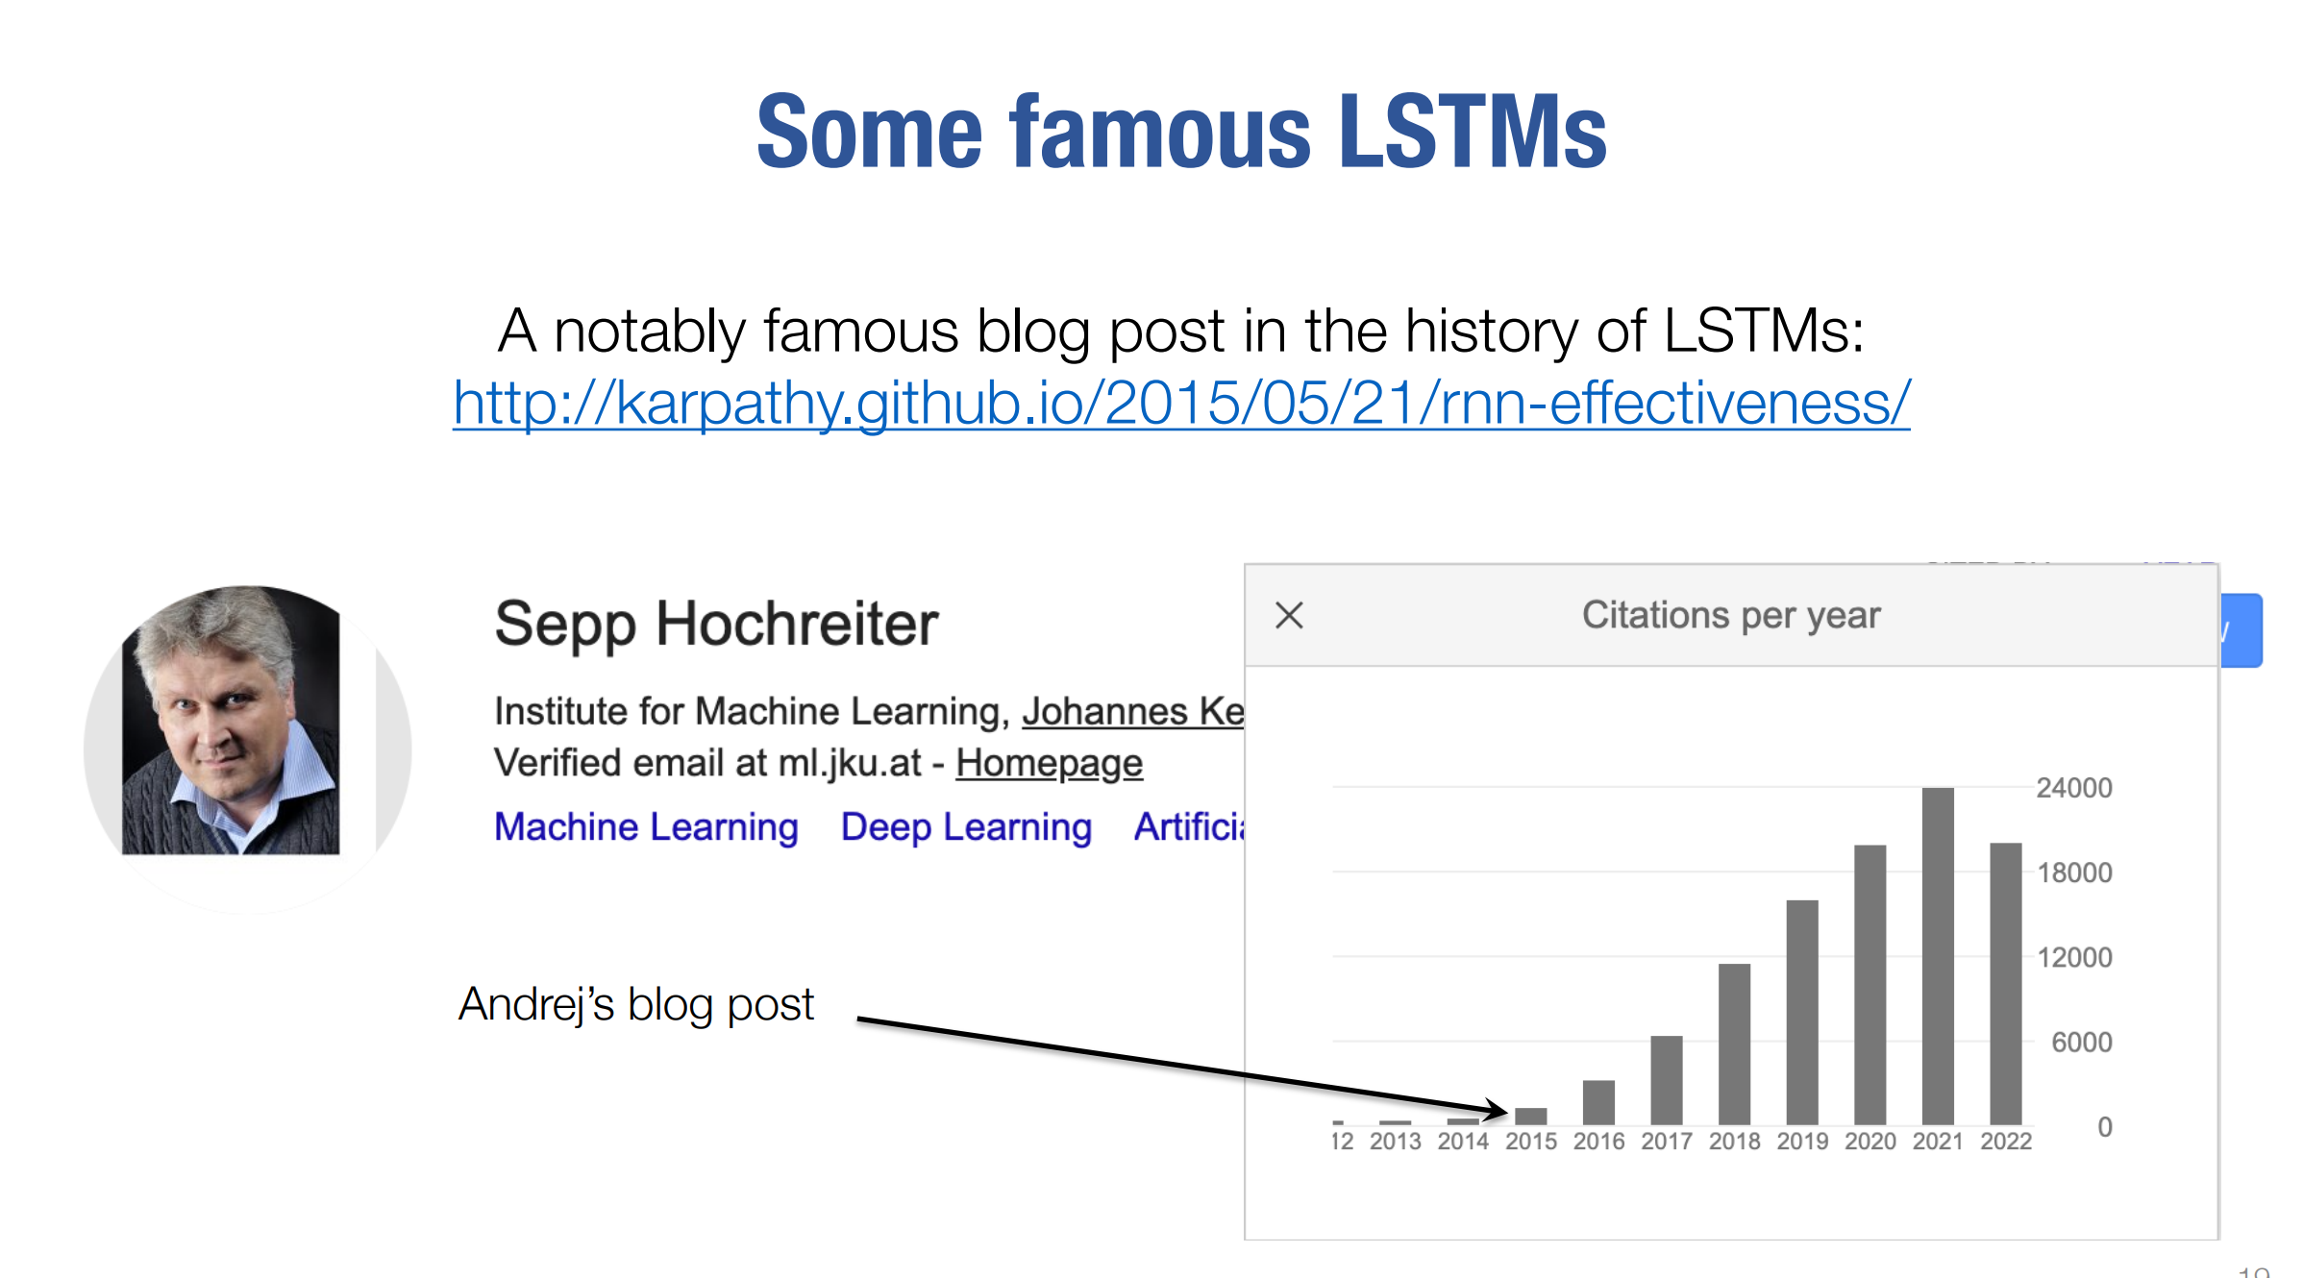

Slide 62
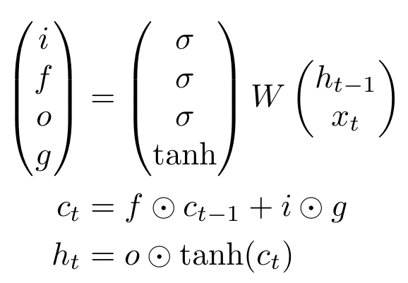
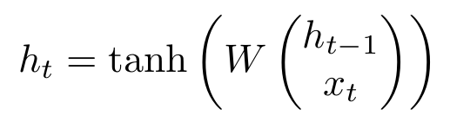
Long Short Term Memory (LSTM)
Vanilla RNN
LSTM
Hochreiter and Schmidhuber, “Long Short Term Memory”, Neural Computation 1997
Slide Credit: Fei-Fei Li, Justin Johnson, Serena Yeung, CS 231n

Slide 63
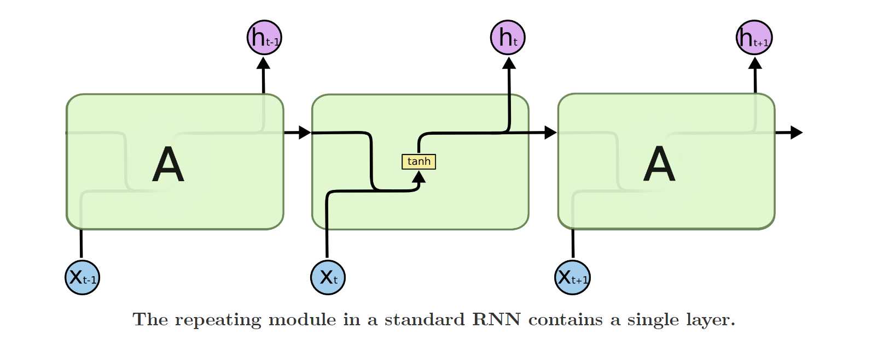
Understanding LSTM Networks -- colah's blog

Slide 64
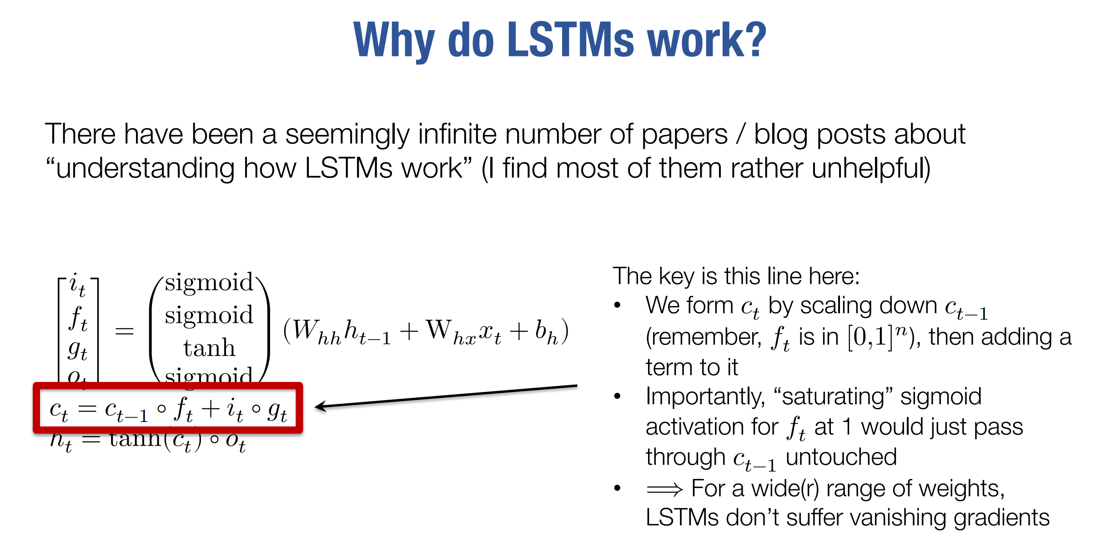

Slide 65


Meet LSTMs
Image Credit: Christopher Olah (http://colah.github.io/posts/2015-08-Understanding-LSTMs/)

Slide 66

LSTMs Intuition: Memory
Cell State / Memory
Image Credit: Christopher Olah (http://colah.github.io/posts/2015-08-Understanding-LSTMs/)

Slide 67
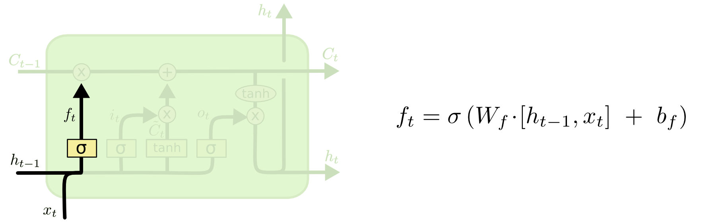
LSTMs Intuition: Forget Gate
Should we continue to remember this “bit” of information or not?
Image Credit: Christopher Olah (http://colah.github.io/posts/2015-08-Understanding-LSTMs/)

Slide 68
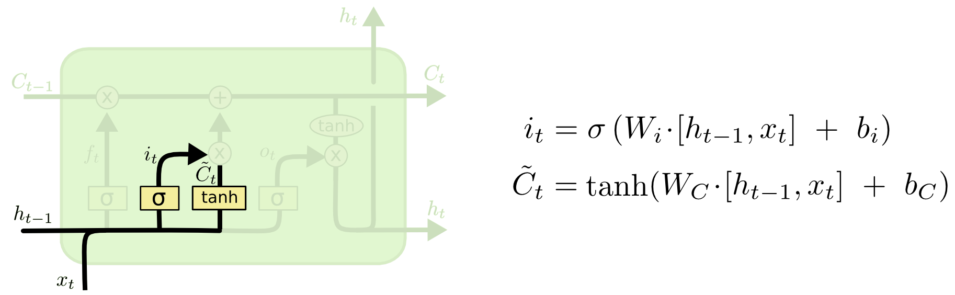
LSTMs Intuition: Input Gate
Should we update this “bit” of information or not?
If so, with what?
Image Credit: Christopher Olah (http://colah.github.io/posts/2015-08-Understanding-LSTMs/)

Slide 69
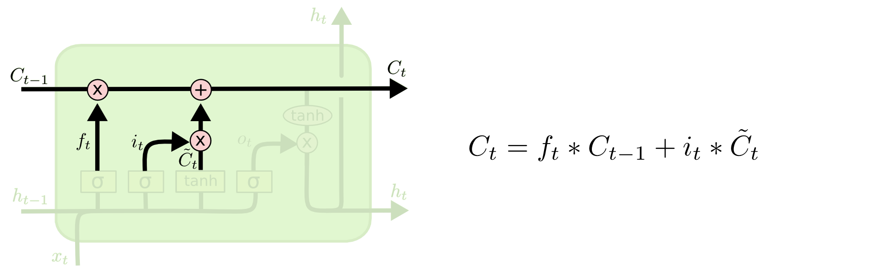
LSTMs Intuition: Memory Update
Forget that + memorize this
Image Credit: Christopher Olah (http://colah.github.io/posts/2015-08-Understanding-LSTMs/)

Slide 70
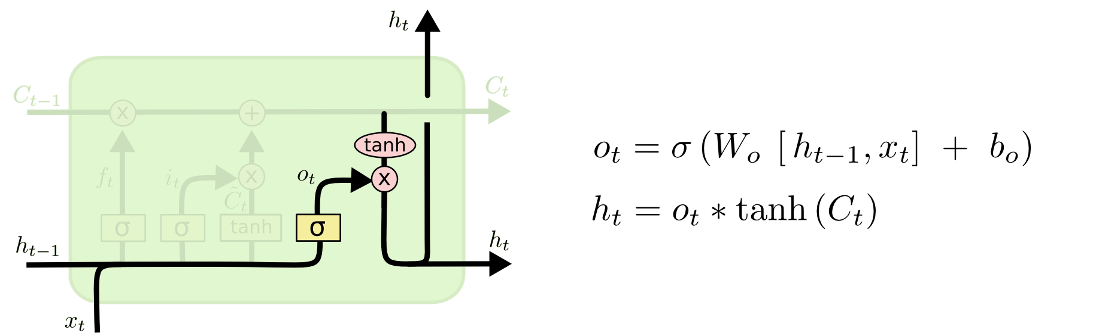
LSTMs Intuition: Output Gate
Should we output this “bit” of information to “deeper” layers?
Image Credit: Christopher Olah (http://colah.github.io/posts/2015-08-Understanding-LSTMs/)

Slide 71
LSTMs Intuition: Additive Updates
Gradient Highway…
Backpropagation from c_{t} to c_{t-1} only elementwise multiplication by f, no matrix multiply by W
Image Credit: Christopher Olah (http://colah.github.io/posts/2015-08-Understanding-LSTMs/)

Slide 72
LSTMs Intuition: Additive Updates
Uninterrupted gradient flow!
Image Credit: Christopher Olah (http://colah.github.io/posts/2015-08-Understanding-LSTMs/)

Slide 73
LSTMs Intuition: Additive Updates
Uninterrupted gradient flow!
Similar to ResNet!
3x3 conv, 128
...
3x3 conv, 128
3x3 conv, 128
3x3 conv, 64
3x3 conv, 128
3x3 conv, 64
3x3 conv, 64
7x7 conv, 64 / 2
3x3 conv, 64
FC 1000
3x3 conv, 128 / 2
3x3 conv, 128
3x3 conv, 64
3x3 conv, 64
3x3 conv, 64
Pool
3x3 conv, 64
3x3 conv, 64
Input
3x3 conv, 64
3x3 conv, 64
3x3 conv, 64
Pool
Softmax
Image Credit: Christopher Olah (http://colah.github.io/posts/2015-08-Understanding-LSTMs/)

Slide 74
LSTMs
A pretty sophisticated cell
Image Credit: Christopher Olah (http://colah.github.io/posts/2015-08-Understanding-LSTMs/)

Slide 75
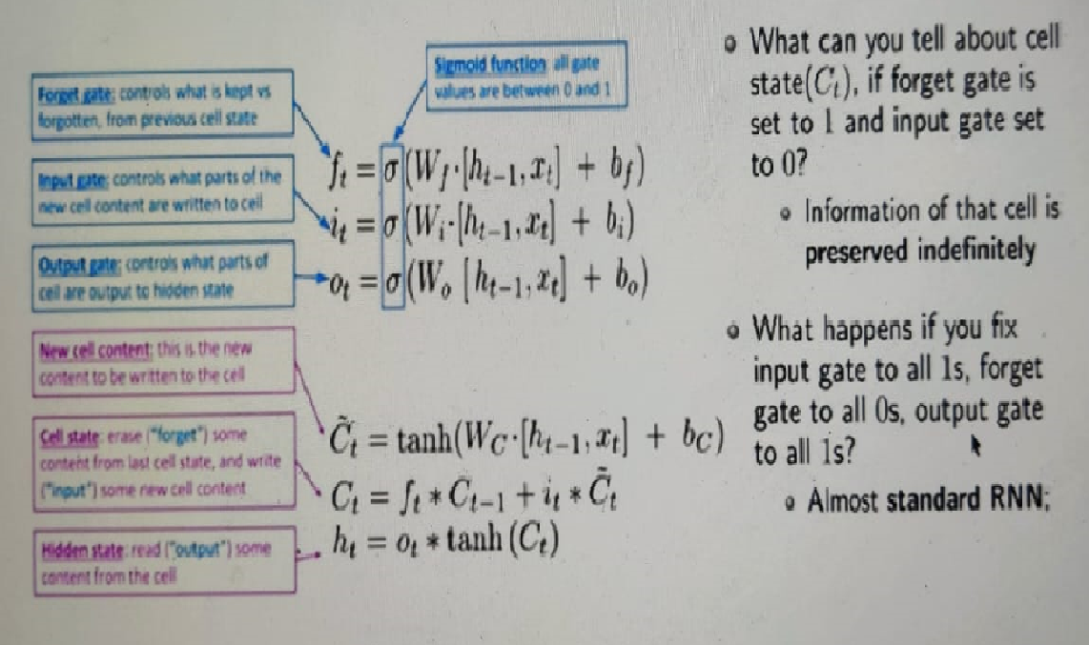

Slide 76
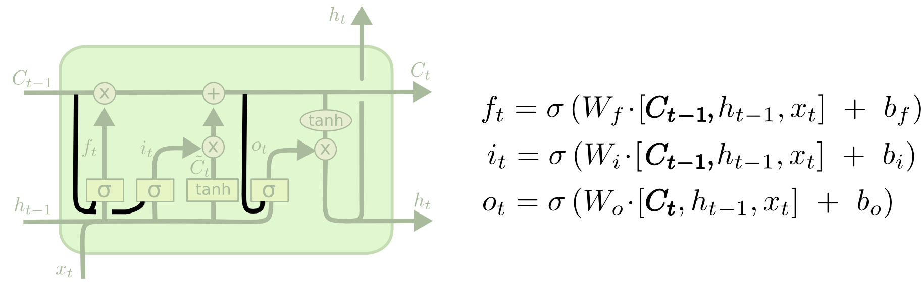
LSTM Variants #1: Peephole Connections
Let gates see the cell state / memory
Image Credit: Christopher Olah (http://colah.github.io/posts/2015-08-Understanding-LSTMs/)

Slide 77
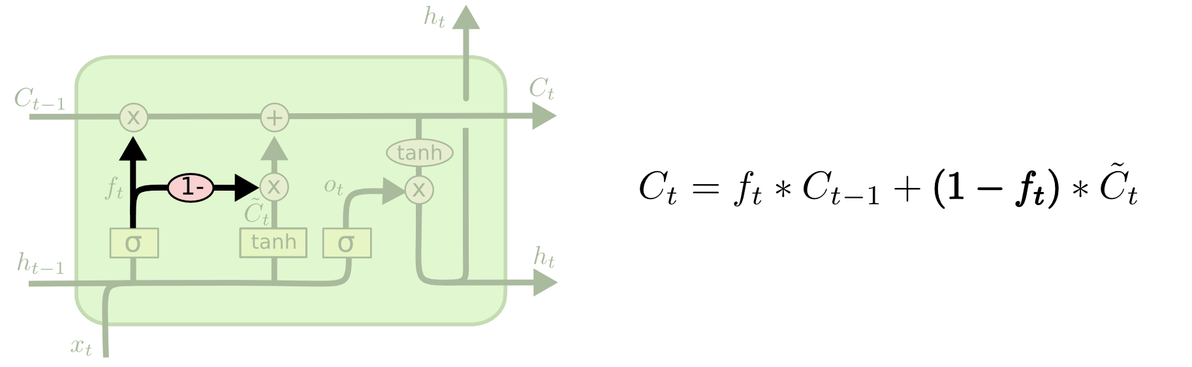
LSTM Variants #2: Coupled Gates
Only memorize new if forgetting old
Image Credit: Christopher Olah (http://colah.github.io/posts/2015-08-Understanding-LSTMs/)

Slide 78
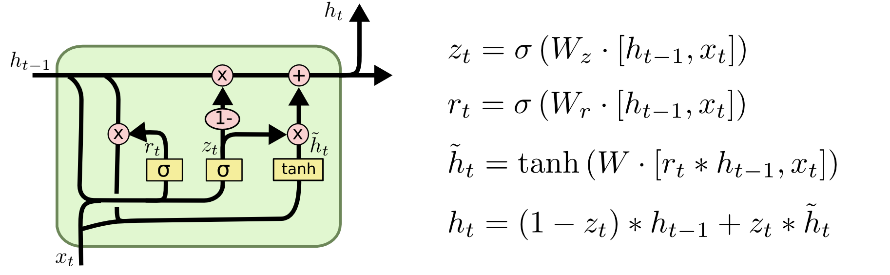
LSTM Variants #3: Gated Recurrent Units
Changes:
No explicit memory; memory = hidden output
Z = memorize new and forget old
Image Credit: Christopher Olah (http://colah.github.io/posts/2015-08-Understanding-LSTMs/)

Slide 79
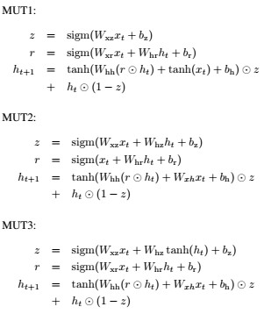
Other RNN Variants
[An Empirical Exploration of
Recurrent Network Architectures,
Jozefowicz et al., 2015]

Slide 80
Plan for Today
Recurrent Neural Networks (RNNs)
Example Problem: (Character-level) Language modeling
Learning: (Truncated) BackProp Through Time (BPTT)
Visualizing RNNs
Example: Image Captioning
Inference: Beam Search
Multilayer RNNs
Problems with gradients in “vanilla” RNNs
LSTMs (and other RNN variants)

Slide 81
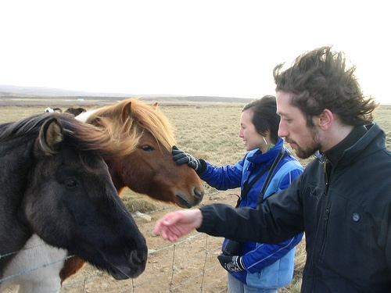
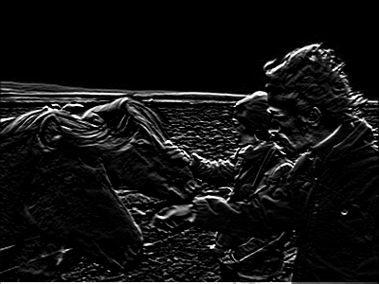
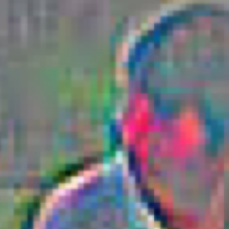
Neural Image Captioning
Image Embedding (VGGNet)
4096-dim
Convolution Layer + Non-Linearity
Pooling Layer
Convolution Layer + Non-Linearity
Pooling Layer
Fully-Connected MLP

Slide 82
Neural Image Captioning
Image Embedding (VGGNet)
4096-dim
Convolution Layer + Non-Linearity
Pooling Layer
Convolution Layer + Non-Linearity
Pooling Layer
Fully-Connected MLP

Slide 83
Neural Image Captioning
P(next)
P(next)
P(next)
P(next)
P(next)
P(next)
Linear
RNN
RNN
RNN
RNN
RNN
RNN
<start>
Two
people
and
two
horses.

Slide 84
Neural Image Captioning
P(next)
P(next)
P(next)
P(next)
P(next)
P(next)
Linear
RNN
RNN
RNN
RNN
RNN
RNN
<start>
Two
people
and
two
horses.

Slide 85
Sequence Model Factor Graph

Slide 86
Beam Search Demo
http://dbs.cloudcv.org/captioning&mode=interactive

Slide 87


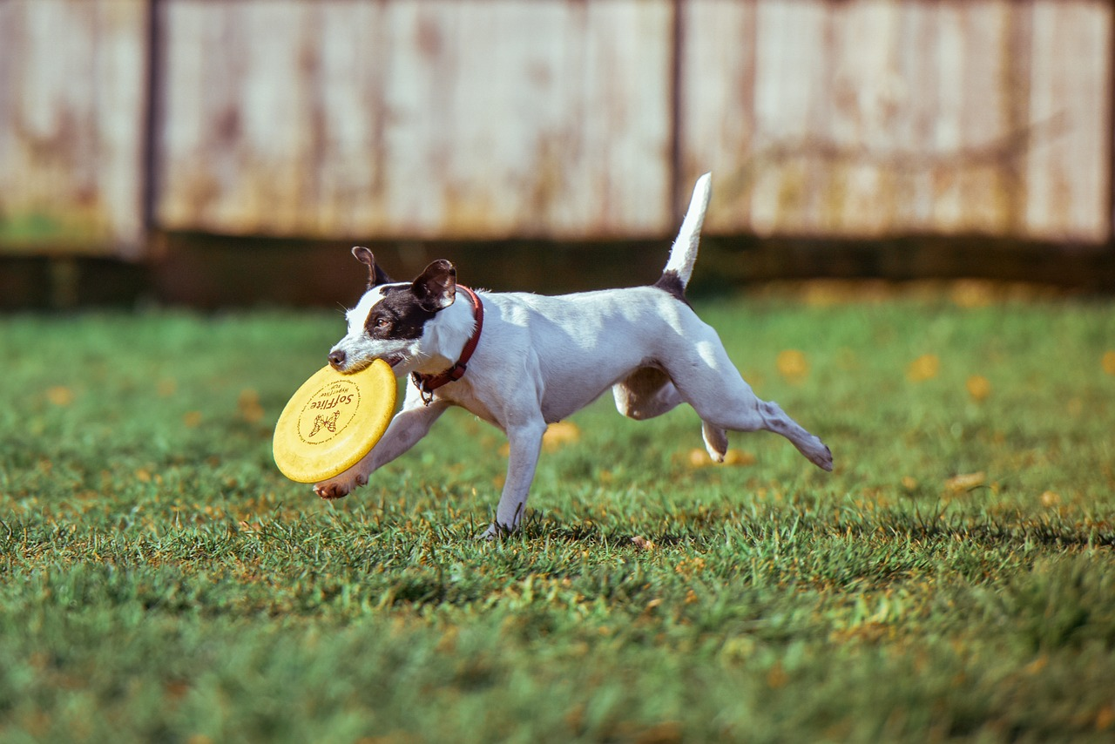


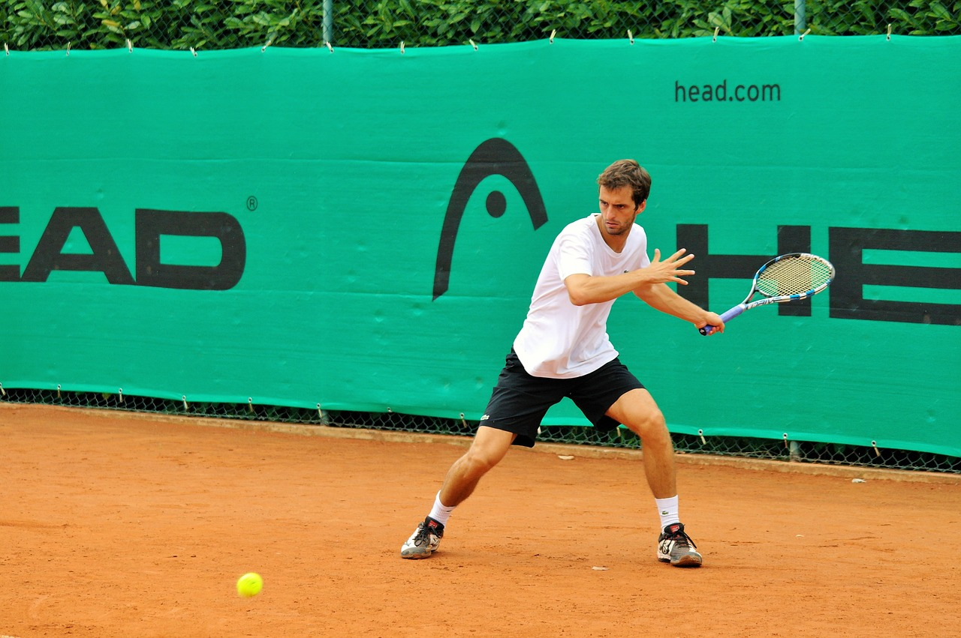
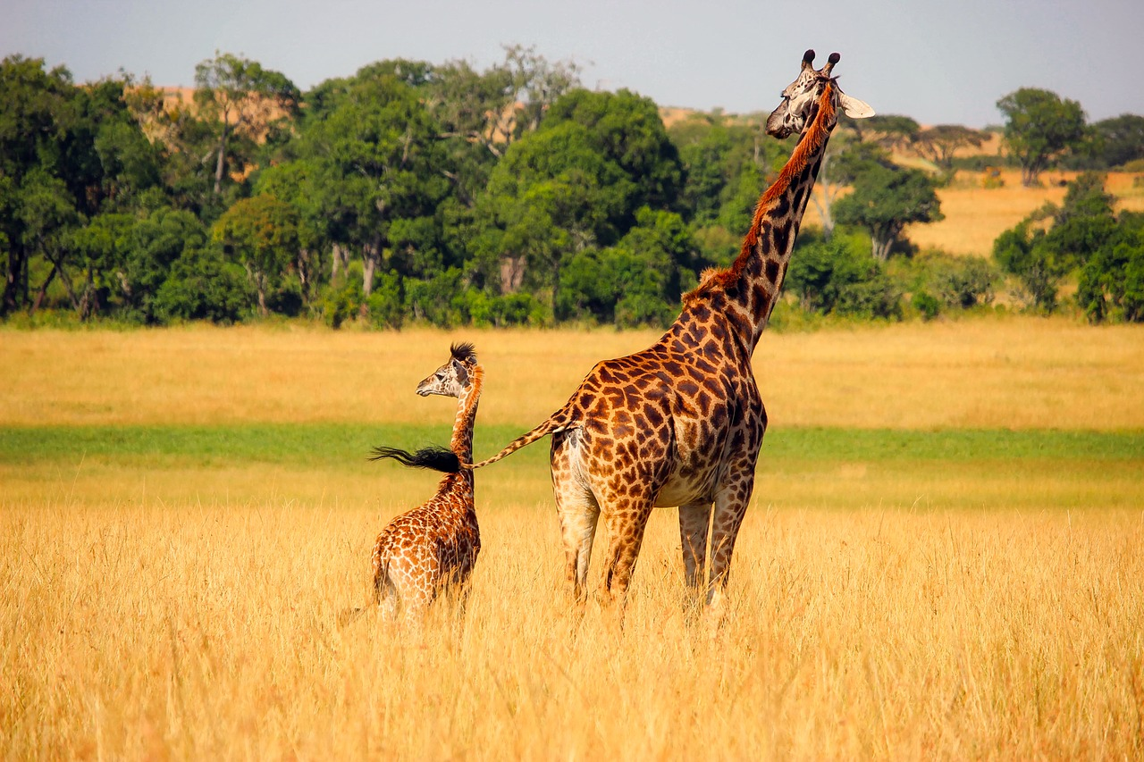
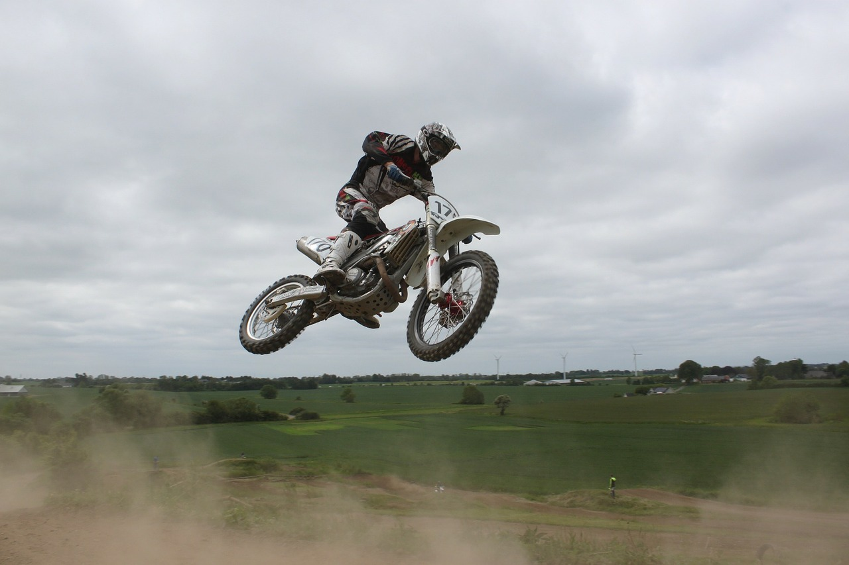
Image Captioning: Example Results
Captions generated using neuraltalk2
All images are CC0 Public domain: cat suitcase, cat tree, dog, bear, surfers, tennis, giraffe, motorcycle
A cat sitting on a suitcase on the floor
A cat is sitting on a tree branch
A dog is running in the grass with a frisbee
A white teddy bear sitting in the grass
Two people walking on the beach with surfboards
A tennis player in action on the court
Two giraffes standing in a grassy field
A man riding a dirt bike on a dirt track
Slide Credit: Fei-Fei Li, Justin Johnson, Serena Yeung, CS 231n

Slide 88


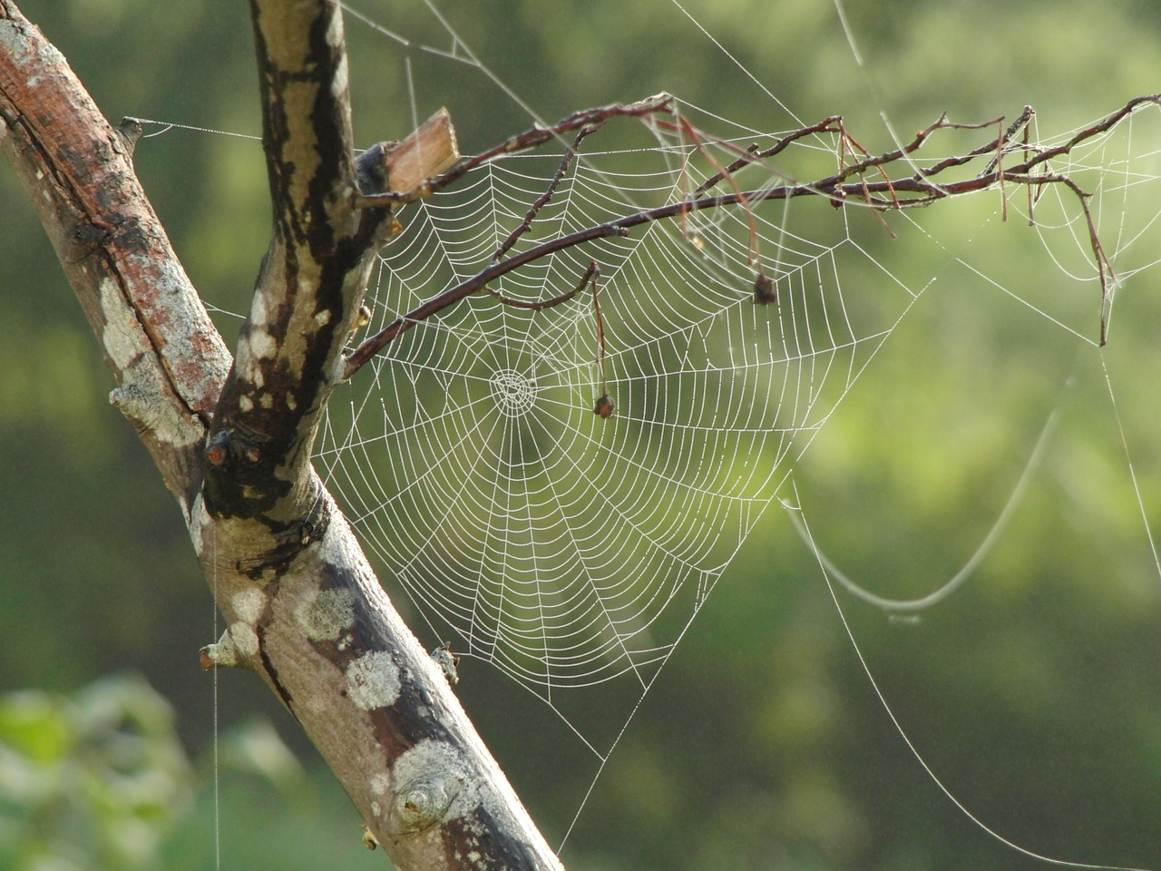


Image Captioning: Failure Cases
Captions generated using neuraltalk2
All images are CC0 Public domain: fur coat, handstand, spider web, baseball
A bird is perched on a tree branch
A woman is holding a cat in her hand
A man in a baseball uniform throwing a ball
A woman standing on a beach holding a surfboard
A person holding a computer mouse on a desk
Slide Credit: Fei-Fei Li, Justin Johnson, Serena Yeung, CS 231n

Slide 89
Summary
RNNs allow a lot of flexibility in architecture design
Vanilla RNNs are simple but don’t work very well
Common to use LSTM or GRU: their additive interactions improve gradient flow
Backward flow of gradients in RNN can explode or vanish. Exploding is controlled with gradient clipping. Vanishing is controlled with additive interactions (LSTM)
Better/simpler architectures are a hot topic of current research
Better understanding (both theoretical and empirical) is needed.

